Slide 1
Architecting Internet of Things Solutions

Slide 2
Agenda
What’s with all the IoT buzz?
Design devices first
Deep dive on Event Hub
Azure Stream Analytics
Azure IoT reference architecture

Slide 3
Why IoT?

Slide 4





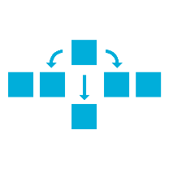
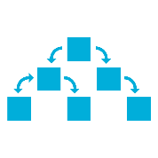
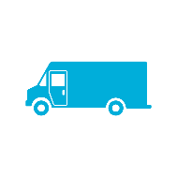



Microsoft’s Approach to IoT
Command and Control
You have things…
that you get data from and store…
that you perform insights on…
that allows you to do…
Plant Floor
Things
Back Office
Things
Supply Chain
Things
HDInsight
Power BI
Cloud Storage
Predictive
Maintenance
Command and
Control

Slide 5
IoT 2010
Alarm clock
Refrigerator
Automobile
VoIP phone
Computer
Printer
Media player
Microwave
COMMUTE
COMMUTE
HOME
WORKPLACE
HOME
Coffee maker
Smart scale
Oven
Cell phone
HVAC
Vending
Security
Television

Slide 6
















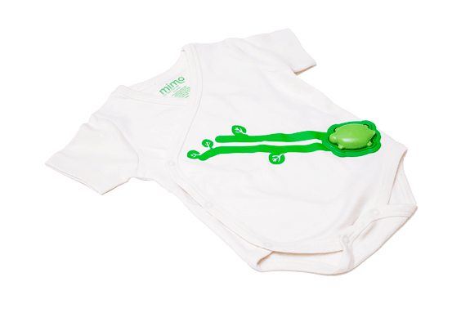
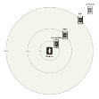












































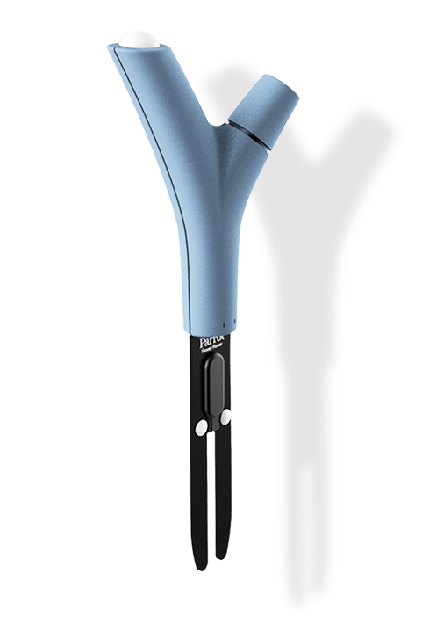









IoT 2015
Medication adherence
Health monitoring
Pet tracking
Behavior modification
Object tracking
Child and elder monitoring
Sports and fitness
Indoor navigation
Trip tracking and car health
Smart lighting
Beacons and proximity
COMMUTE
COMMUTE
HOME
WORKPLACE
HOME
Smart appliances
Food and nutrition tracking
Identity
Office equipment
Smart vending machines
Bike ride stats and protection
Air conditioning and temperature control
Sleep tracking
Environmental sensors
Information capture
Control
Home security
Home automation
Leak detection
Garden, lawn and plant care
New devices and sensors
Entertainment systems

Slide 7
Design devices first

Slide 8
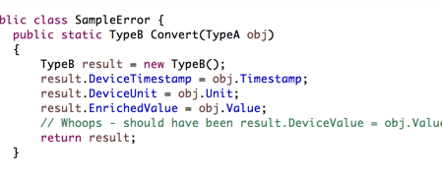
Cost of the oops - Services
Oops. Inverted a variable assignment. Cost of fixing: edit, commit, push, build, deploy.

Slide 9
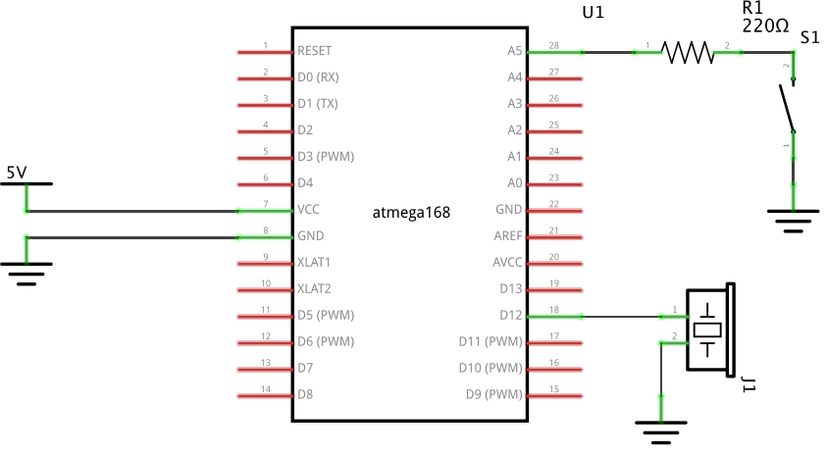
Cost of the oops - Devices
Oops. Put the piezo electric buzzer on a general purpose I/O pin, not a pulse width modulation (PWM) pin.
Not enough processor cycles to handle software- based PWM: would destroy battery life.
Cost to fix: $100k, including 6-week product ship delay.

Slide 10
Needs of the device outweigh needs of the service
Devices have to be designed, manufactured, programmed, shipped, and provisioned.
Devices consume: battery, heat, network bandwidth, and network sockets.
Commercially viable products and services must maintain operational cost of goods sold (CoGS).
Device choices endure—sometimes for decades!

Slide 11
JSON all the things
Device used for vehicle monitoring
Vertical business model (device manufacturer runs end-to-end service)
Connected via cellular link; pay per byte
Efficiency of communication = gross margins
Notes:
So we could certainly use XML instead of JSON, but why use JSON?
- XML is more characters to send/receive/process and you want to avoid that on devices

Slide 12
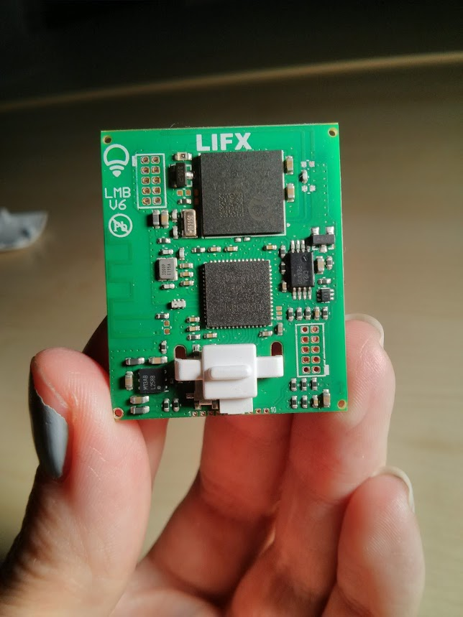
Peer to peer sounds awesome!
LIFX lightbulbs create a mesh network between each other.
One lightbulb elects as master, and proxies to Wi-Fi router.
Devices shipped from factory with a single GLOBAL PRE-SHARED KEY.
Break one device—break them all.
http://contextis.com/resources/blog/hacking-internet-connected-light-bulbs/

Slide 13
Remediation?
Global firmware update: How do the devices “call home” to get firmware updates? At scale there will always be devices behind the update curve.
Do not make any mistakes in the bootloader for in-field firmware updates. A single return material authorization (RMA) can wipe out the profit from dozens of devices.
Move to provisioned key-per-device. Need to build and manage key infrastructure. Also need to incorporate key rotation. (Do not make a mistake here or the device will “bricked.”)
Is there an out-of-band update mechanism (USB)? Is the end-user community amenable to handling firmware updates (industrial and technical versus mass consumer)?
http://contextis.com/resources/blog/hacking-internet-connected-light-bulbs/

Slide 14
Azure IoT Reference Architecture
Notes:
Let’s review what a typical IoT architecture in the cloud looks like.

Slide 15
Canonical Event-Driven Scenario
Event producers
Collection
Ingestion (broker)
Transformation
Long-term storage
Presentation and action
Stream Processing
Web/thick client dashboards
Applications
Service bus
Data
Ingestion
Service
Databases
Legacy IoT (custom protocols)
Stream processing
Search and query
Cloud gateways (web APIs)
Storage
Devices
Storage adapters
Big Data
Data analytics (Excel)
IP-capable devices (Windows/Linux)
Low-power devices (RTOS)
Field gateways
Devices to take action
Notes:
If we look at a typical IoT architecture in the cloud, we have the devices/applications sending telemetry either directly to the cloud, or first through a field gateway, which then sends the data to the cloud. Some devices that can talk directly to the cloud might use a special protocol that Azure doesn’t support. For instance, MQTT is used for low-power devices and the Data Ingestion Service might only support AMQP/HTTP(s), which requires a custom Cloud Protocol Gateway to convert the protocol used on the device to a supported Protocol in the cloud. For devices that aren’t able to talk directly to the cloud, they will usually go through a custom Field Gateway, which receives the telemetry from device(s) and sends it to the cloud. An example of this might be where you have a Microsoft Band that tracks your running data, which doesn’t talk directly to the cloud, but uses your phone as a Field Gateway with an application to process the data and send it to a Data Ingestion Service. Or, for more commercial examples there might be a server in an office or on a factory floor that receives the data from either a Wi-Fi or Bluetooth connection and pushes it to the cloud. You might even have a need to have a Field Gateway talk to a Cloud Protocol Gateway as well.
From the Data Ingestion Service, now that the telemetry data is in the cloud, it will need to be processed and stored, and most likely have some analytics run and presented through an application and/or reporting dashboard. Depending on the results of the processing, there might be some discoveries that will push special events into a Service Bus Queue to trigger actions within the workflow such as alerts. The data can also end up in a Big Data store for batch/real-time querying/analysis of the data.

Slide 16
Canonical Event-Driven Scenario
Event producers
Collection
Ingestion (broker)
Transformation
Long-term storage
Presentation and action
Storm or
Spark
Cluster
Web/thick client dashboards
Applications
Service Bus
Kafka
Databases
Legacy IoT (custom protocols)
Stream processing
Search and query
Cloud gateways (web APIs)
Storage
Devices
Storage adapters
Big Data
Data analytics (Excel)
IP-capable devices (Windows/Linux)
Low-power devices (RTOS)
Field gateways
Devices to take action
Notes:
If you were to look at implementations of an IoT architecture that isn’t specific to Azure, you might find things like Kafka as the Data Ingestion Service, and maybe Storm or Spark clusters for the Stream Processing. Let’s look at the next slide to see what this might look like in Azure.

Slide 17

Canonical Event-Driven Scenario
Event producers
Collection
Ingestion (broker)
Transformation
Long-term storage
Presentation and action
Stream Analytics
Power BI
Applications
Service Bus
Event Hubs
& IoT Hub
Azure DBs
Legacy IoT (custom protocols)
Azure Search
Cloud gateways (web APIs)
Stream processing
Azure storage
Devices
Storage adapters
HDInsight
Excel
IP-capable devices (Windows/Linux)
Data Ingestion
Low-power devices (RTOS)
Field gateways
Xamarin Applications
Notes:
Azure IoT Suite provides PaaS services such as Event Hubs and IoT Hub to ingest the data, as well as Azure Stream Analytics to process the data in real-time and output the results to most of the major data sources in Azure. Azure Stream Analytics can output to things like Azure Service Bus for events like alerts that need to be handled, SQL Database or SQL Data Warehouse for relational data, Azure Storage for Blob and Table Storage, DocumentDB, as well as HDInsight for a managed Hadoop cluster. The data can then be visualized in Power BI, Excel, custom mobile apps using Xamarin, Azure Search and more.
Another thing to think about is once you have events in the Service Bus, you might want to use a WebJob to asynchronously process the events and handle any alerts/notifications to dashboards or mobile devices. PagerDuty is a great third-party application that allows you to use webhooks and get dashboard and mobile notifications to the appropriate users without having to build your own.

Slide 18
Deep Dive on Event Hub

Slide 19
Hyper Scale. A Million Clients. Concurrent.
100
10,000
1,000,000

Slide 20
Introducing Azure Event Hubs
IEventProcessor
Event Processor Host
Azure Event Hub
Direct
Receivers
> 1M Producers > 1GB/sec Aggregate Throughput
Consumer Group(s)
Partitions
Event Producers
PartitionKey
Hash
AMQP 1.0
Credit-based flow control
Client-side cursors
Offset by Id or Timestamp
Throughput Units:
1 ≤ TUs ≤ Partition Count
TU: 1 MB/s writes, 2 MB/s reads
Up to 32 partitions via portal, more on request

Slide 21
Partitions
Segmentation of the event stream for scale-out
Parallelism for consumers pulling events for processing
Parallelism for producers submitting events
Default 16, minimum 8, self-service maximum 32
Azure Support can enable up to 1024 (or more under special conditions)
Maximum 10 Event Hubs per namespace
Sender usage of partitions
Direct targeting with partition-id allowing for sender controlled segmentation
Automatic hash-based distribution by PartitionKey or Publisher Identity
Automatic random distribution

Slide 22
Throughput Units
Throughput Unit (TU): Quota and Billing Concept
Write: Lesser of 1MByte/sec or 1000 message operations/sec (incl. management)
Read: 2MByte/sec
Included retention: 84GByte/day (24h at full ingress rate)
Retention can be expanded w/ self-service up to 7 days, via Azure support up to 30 days
Local-redundant Azure storage pricing for overages applies
Number of Partitions ≥ Throughput Units
At most one throughput unit per partition, minimum is one
10 partitions have 10 TU = 10 MByte/sec throughput ceiling
TUs are applied and enforced at the namespace level, i.e. across Event Hubs
Maximum of 20 TUs per account in self-service.
Further w/ commitments through Azure support (blocks of 20 up to 100, blocks of 100)
Billing
TUs are billed by the hour (!) they are applied to a namespace (more on pricing later)

Slide 23
Publishers
Very many publishers
Short-lived, low throughput: HTTPS
Long-lived, high throughput: AMQP
Long lived AMQP connections are billable, HTTPS requests are not; AMQP connection allowance included in tier
Publish to …
PartitionId
Direct
PartitionKey
PartitionKey selecting PartitionId
Publisher Policy (<eh>/publishers/<name>)
<name> overriding PartitionKey
Direct
Partitions
Event Producers
PartitionKey
Hash

Slide 24
Consumer Groups
Views on the Event Stream
Conceptually similar to Topic subscriptions in that they are a ‘view’ on the event stream
Organizational anchor for checkpointing (you)
Anchor for creating per-partition receivers
Default consumer group always present
Can create up to 20 named consumer groups
“Receivers read through a consumer group”
Consumer Group(s)

Slide 25
Consumers
Receive from partitions via consumer groups
Using .NET API or using generic AMQP 1.0 client (e.g. Apache Proton-C/J)
Cursors (offsets) solely maintained by clients; not like Queue/Topic
Maximum flexibility for consumption
Can act as raw event history store for retention duration
Not an archive, but raw data value often deteriorates quickly
Can synchronize across streams by timestamp
Checkpoints must be maintained by clients
Direct support for external leader election models with epochs
Partition
Event Log
ID, Time, [Data]
ID, Time, [Data]
Time
ID, Time, [Data]
ID, Time, [Data]
ID, Time, [Data]
ID

Slide 26
Event Hub producers and consumers

Slide 27
Event Hub Pricing
How much to send a million events a week?
$10K / Month?
$20K / Month??
Notes:
How much do you think it would cost to send a million events a week? $10K/month? $20K/month? Let’s go to the Azure Pricing Calculator and find out.
<Go to the Pricing Calculator online and calculate it, and show it’s ridiculously cheap>

Slide 28
Azure Stream Analytics

Slide 29



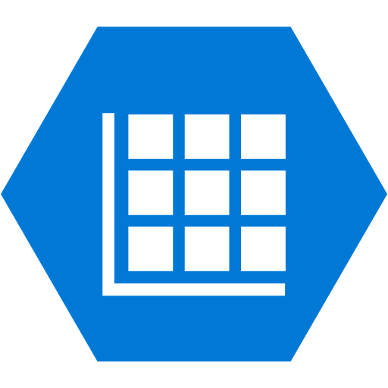

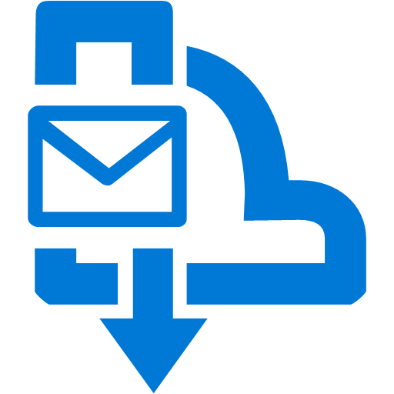
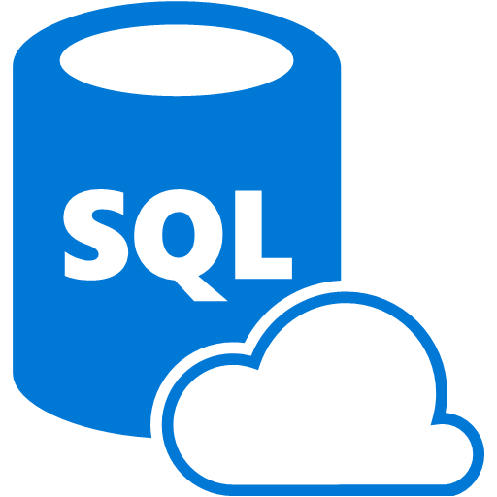

Azure Stream Analytics
Complex Event Processing of Stream Data in Azure
Small number of high volume queries
Complex Event Processing (aggregation, reduction, cleanup)
Predictable & repeatable results
SQL-like queries
Ingress Azure blobs and Event Hub
Egress to Event Hub, blobs, tables, Service Bus topics, Service Bus queues, Azure SQL Database, and Power BI
Input Adapter
Complex Event Processor
Output Adapter
Notes:
Azure Stream Analytics provides complex event processing of stream data as a service. Somewhat narrower in scope than Storm on HDInsight, Azure Stream Analytics provides a simple and very cost-effective way to process complex events. For instance, analyze streams of data for time-sequence relationships, all with a SQL-like query. Output data to Power BI to provide near-real-time reporting.
The nice thing about ASA is that it can be your hub for all data to come in and easily send it somewhere else without having to code and push new applications (like with Storm/Spark). New outputs are being added every month and it gives you the benefit of being able to add new functionality and workflows with minimal effort.

Slide 30
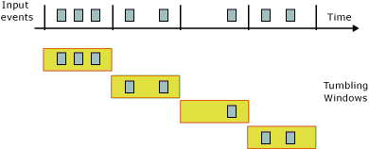
Tumbling Windows
How many vehicles entered each toll both every 5 minutes?
SELECT TollId, COUNT(*) FROM EntryStream
GROUP BY TollId, TumblingWindow(minute,5)

Slide 31
Azure Stream Analytics Demo

Slide 32
Azure IoT Reference Architecture
Devices and Data Sources
Data Transport
Device and Event Processing
Presentation
Azure IoT Hub
Data Visualization & Presentation
IoT Suite
IP capable devices
Provisioning API
Solution Portal
Device State Store
Agent
Device Registry Store
Existing IoT devices
Stream Event Processor
Agent
Gateway
Storage
Analytics/ Machine Learning
Low power devices
Agent

Slide 33
Azure IoT Hub
Designed for IoT
Connect millions of devices
Service assisted communications
Devices are not servers
Use IoT Hub to enable secure bi-directional communications
Cloud-scale messaging
Device-to-cloud and Cloud-to-device
Durable messages (at least once semantics)
Cloud-facing feedback
Delivery receipts, expired messages
Device communication errors
Per-device authentication
Individual device identities and credentials
Connection multiplexing
Single device-cloud connection for all communications (C2D, D2C)
Multi-protocol
Natively supports AMQP, HTTPS, MQTT
Designed for extensibility to custom protocols
Multi-platform
Device SDKs available for multiple platforms (e.g. RTOS, Linux, Windows)
Multi-platform Service SDK.
Notes:
When architecting IoT solutions, if there is a requirement where you need to be able to send messages back to the device or manage the devices, instead of Event Hubs you will want to look at IoT Hub. IoT Hub adds functionality like device registration, bi-directional communication (command and control), and firmware upgrading. You can also connect millions of devices. IoT Hub supports the AMQP, HTTPS and MQTT (New!) protocols.

Slide 34
IoT Hub & IoT Suite Demo
Notes:
Create an IoT Suite for both the Predictive Analytics and Sensor projects (the only available ones currently). Show how what they can do.

Slide 35
Summary
IoT enables new business scenarios
Design device capabilities first
Event Hub provides massive ingest
Azure Stream Analytics is your base station for transformation
IoT Hub / IoT Hub is the future

